Slide 1
CAM Expo Hormones & Neurotransmitters
Imbalances involved in anxiety,
depression and trauma; benefits of dietary support and specific
nutritional supplementation.
By Antony haynes
Nutritional therapist

Slide 2
Antony Haynes
BA(Hons) – Sports Science Degree, 1987
Dip ION – Nutritional Therapy, 1992 & 1994
Registered with BANT & CNHC
Practitioner & Lecturer since 1992
Co-Founder & Head of Technical Services, Nutri-Link since 1996
The Insulin Factor book – 2004
The Food Intolerance Bible – 2005
CAM Magazine ‘Outstanding Practice’ Award 2011
CAM Expo – 22.10.11 - Antony Haynes

Slide 3
Syllabus (1)
Introduction to the subject & brief review of some books on the subject.
Brief overview of some books linking food & nutrition with the hormones & mood
Key hormones & neurotransmitters

Slide 4
Syllabus (2)
5. Identifying imbalances in these hormones & neurotransmitters
6. Questionnaires to assess imbalances
7. Dietary measures to support the hormones & neurotransmitters
8. Supplement support for balancing the hormones & neurotransmitters

Slide 5
Technical Support
To help you decide if specific nutrients could be helpful to you to balance your hormones & neurotransmitters, please do call, for no charge, the Nutri-Link Technical Support
Direct line, local call rate: 08458 94 97 67

Slide 6
Relevant Books on the Subject
The Insulin Factor, 2004
Antony Haynes
CAM Expo – 22.10.11 - Antony Haynes

Slide 7
Relevant Books on the Subject
Cortisol Connection: Why Stress Makes You Fat and Ruins Your Health - And What You Can Do about It by Shawn Talbott, 2002, 2007
CAM Expo – 22.10.11 - Antony Haynes

Slide 8
Relevant Books on the Subject
The Diet Cure, 1999, 2001
Julia Ross

Slide 9
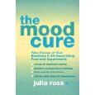
Relevant Books on the Subject
The Mood Cure, 2002, 2003, 2009
Julia Ross

Slide 10
Relevant Books on the Subject
Good Food Good Mood, 1992, 2001
Gary Null

Slide 11
Relevant Books on the Subject
Freedom from Disease: The Breakthrough Approach to Preventing Cancer, Heart Disease, Alzheimer's, and Depression by Controlling Insulin by Peter Morgan Kash, Jay Lombard, and Tom Monte, June 2009

Slide 12
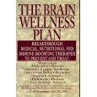
Relevant Books on the Subject
Dr Jay Lombard & Carl Germano, 1997

Slide 13
Summary
Insulin & cortisol, when out of balance, have profound effects on mood and well-being.
Nutrition plays a key role in the level and balance of these key determinants in our mood.
It is NOT possible to measure levels of neurotransmitters with blood or urine tests (ref Dr Jay Lombard).
Specific signs & symptoms give a sound clinical picture of neurotransmitter imbalances.
The appropriate eating plan and key nutrients have been shown to correct imbalances in these hormones & neurotransmitters.

Slide 14
Hormones & Neurotransmitters
Insulin & Cortisol
And
Glutamine / Glutamate
Dopamine
GABA
Serotonin

Slide 15
Neurotransmitters
Nor-Adrenaline
Glutamate
Serotonin
Dopamine
GABA
Acetylcholine
Notes:
Like any conversation when two parties are not hearing one another, misinterpretation leads to bad feelings or failed projects (poor directions)
Principles of Signal Transduction in Neuropsychiatry
Signal transduction is defined as a cascade of biochemical events in which cells translate extracelluar signals into molecular responses
The initial step in this cascade is the binding of the neurotransmitter to the post synaptic receptor-lipoprotein complex
Mood disorders and cognitive disorders are a consequence of errors in signal transduction
million men in the United States each year
Serotonin (ser-oh-TOE-nin) and norepinephrine (nor-ep-i-NEF-rin) are two chemicals called neurotransmitters that exist naturally in your brain and play a role in mood regulation.
Serotonin plays a role in the onset of sleep as well as having an effect on the amount of deep sleep. People who have a shortage of deep sleep also known as stage 4 delta sleep have problems with grogginess and alertness during their waking hours.
Dopamine (DOE-puh-mene) might also play a role in depression. Very tight correlation between the severity of REM sleep behavior disorder and the level of decrease in dopamine. Maybe there's a causal effect. Amount of dopamine loss in the brain correlates with REM disorder."
Many antidepressants work by increasing the levels of these neurotransmitters in the brain synapses.
GABA -Popularly referred to as the body's natural tranquilizer, GABA (gamma-aminobutyric acid) is an amino acid produced in the brain. It acts as a neurotransmitter--a chemical that fosters communication between nerve cells--and helps to keep stress-related nerve impulses at bay. Normally, the brain pumps out all the GABA we need. Unfortunately, due to a poor diet, exposure to environmental toxins, or other factors, levels of GABA may become depleted. Too little of this important compound may result in anxiety, irritability, and insomnia. A deficiency of GABA has also been linked to depression.

Slide 16
Neurotransmitters
And how to positively influence them with Nutritional Therapy (food and specific supplements).

Slide 17
Insulin & Cortisol
Imbalances in insulin & cortisol are profound and affect every aspect of health.
Excess insulin is the most profoundly inflammatory hormone.
Cortisol is the most powerful anti-inflammatory hormone, but it has negative impact if it is too high.

Slide 18
Cortisol
Changed patterns of serum cortisol levels have been observed in connection with abnormal ACTH levels, clinical depression, psychological stress, and physiological stressors such as hypoglycaemia, illness, fever, trauma, surgery, fear, pain, physical exertion, or temperature extremes.

Slide 19
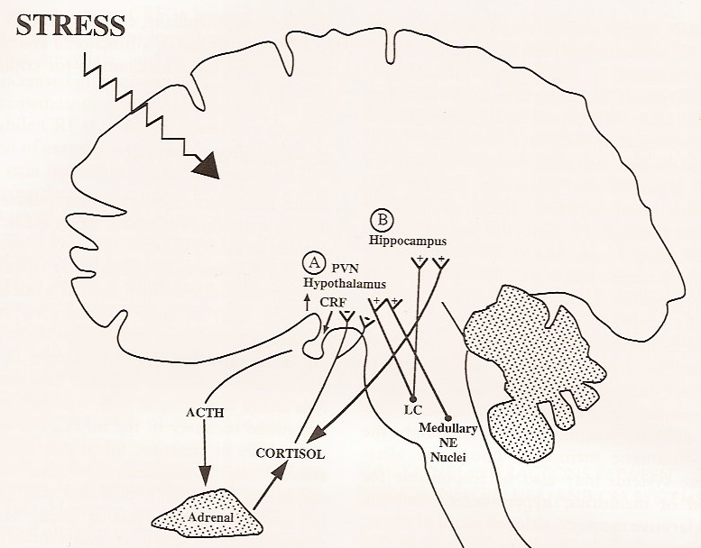
Novel
Unexpected
Threatening
Survival
Sonja Lupien PhD

Slide 20
Cortisol & Insulin
These two hormones have a significant role to play in our mood, anxiety, and depression. Elevated levels of cortisol, in particular, are associated with depression.
A Pub Med search on 18.10.11 found 349 research titles that included the words “cortisol” and “depression”.

Slide 21
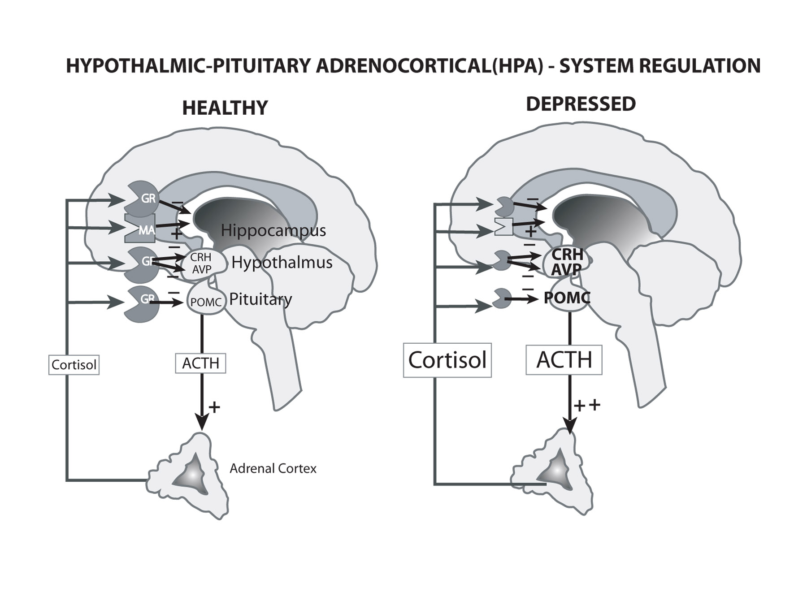

Slide 23
Reducing Stress Hormones Affects Mood
Antagonizing CRF (corticotrophin releasing factor) and glucocorticoid receptors may be effective in treating depression.
Mechanism – interruption of reverberating neuroendocrine loops involving the HPA axis and several areas of the brain (prefontal cortex, amygdala, hippocampus, and hypothalamus)

Slide 24
Neurotransmitters

Slide 25
Neurotransmitters
Neurotransmitters are endogenous chemicals which transmit signals from a neuron to a target cell across a synapse.
Neurotransmitters are packaged into synaptic vesicles clustered beneath the membrane on the presynaptic side of a synapse, and are released into the synaptic cleft, where they bind to receptors in the membrane on the postsynaptic side of the synapse.
Reference
Dorlands Medical Dictionary

Slide 26
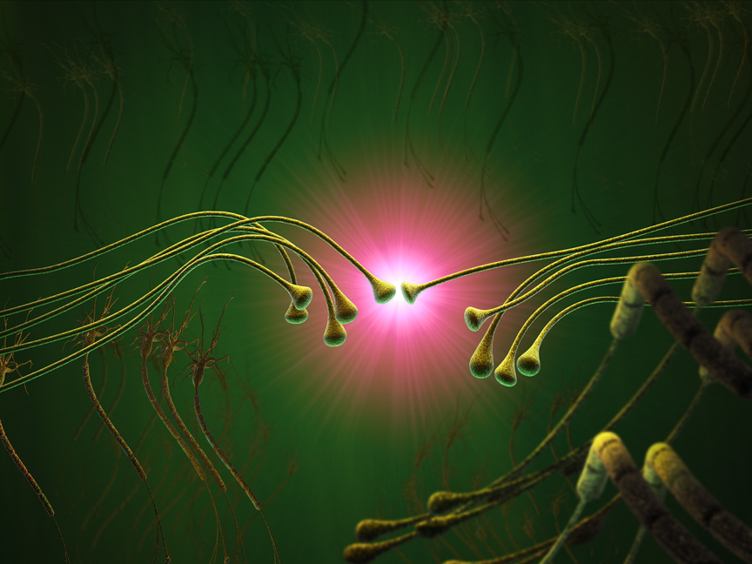

Slide 27
Neurotransmitters
Neurotransmitters are synthesised from plentiful and simple precursors, such as amino acids, which are readily available from the diet and which require only a small number of biosynthetic steps to convert.
Reference
Robert Sapolsky (2005). "Biology and Human Behaviour: The Neurological Origins of Individuality, 2nd edition". The Teaching Company. "see pages 13 & 14 of Guide Book".

Slide 28
Neurotransmitters
Glutamine / Glutamate

Slide 29
Glutamate
Glutamate is used at the great majority of fast excitatory synapses in the brain and spinal cord.
It is also used at most synapses that are "modifiable", i.e. capable of increasing or decreasing in strength.
Modifiable synapses are thought to be the main memory-storage elements in the brain.

Slide 30
Glutamate
Although there is no direct relationship between consumption of glutamine and glutamate levels, those with anxiety or conditions of the CNS are recommended NOT to take high doses.

Slide 31
Glutamate
Main Symptoms
Excitability
Role in Cellular Memory
Pain Perception
Potentiation
Amplification

Slide 32
Glutamate Receptors
Increases phospholipase A2
S. Bleich et al. / Prog Neuropsychopharmacol Biol Psychiatry 28 (2004) 453–64.
Notes:
Once glutamate binds to the receptor, glutamate induces a flow of calcium ions into the cell, increasing the potential of the membrane.
Physiologically, the increased intracellular charge triggers changes in the neuron that ultimately result in the release of many neurotransmitters at the axonal end of the cell.
However, high concentrations of these substances may result in over-excitation of nerve cells and high intracellular calcium concentrations, which could eventually result in cell death, as shown in this figure:
The influx of Ca2+ and large intracellular concentrations of Ca2+ may have detrimental effects for the cell.
How does this situation occur?
The opening of the NMDA receptor is normally blocked by a single magnesium ion (Mg2+).
The Mg2+ ions are only removed when the electrical charge inside the cell rises to a specific value.
The hyper-activation of the NMDA receptor by excitatory amino acids causes an increase in the entry of Ca2+ ions into the cell overcoming the capacity of cellular ion pumps that pump out positively charges ions.
As a result of the increase of free intra-cellular Ca2+, a number of enzymes and proteins that are capable of degrading essential proteins and cellular membranes are activated. In addition to degradation of cell membrane structures and essential proteins, higher Ca2+ ion concentrations also cause an increased concentration of free radicals, which in turn can further increase in the amount of Ca2+ inside the cell.
Homocysteine and homocysteic acid have similar chemical structures as glutamate and may activate the NMDA-receptor and thereby further increase the vulnerability of nerve cells to excitotoxic and oxidative injury.
Cell death eventually results from the combination of oxidative stress, mitochondrial dysfunction, DNA-damage and induction of apoptosis triggered by increased Ca2+ entry.
Thus, high concentrations of homocysteine in the CNS may trigger the cascade of events that follow hyper-activation of the NMDA-receptor ultimately leading to nerve cell death.

Slide 33
Dopamine
Dopamine

Slide 34
Dopamine
Dopamine is a catecholamine neurotransmitter. Dopamine is produced in several areas of the brain, including the substantia nigra and the ventral tegmental area.
Dopamine is also a neuro-hormone released by the hypothalamus. Its main function as a hormone is to inhibit the release of prolactin from the anterior lobe of the pituitary.

Slide 35
Dopamine
Dopamine is available as an intravenous medication acting on the sympathetic nervous system, producing effects such as increased heart rate and blood pressure. However, because dopamine cannot cross the blood-brain barrier, dopamine given as a drug does not directly affect the central nervous system.
To increase the amount of dopamine in the brains of patients with diseases such as Parkinson's disease and dopa-responsive dystonia, L-DOPA (the precursor of dopamine), is often given because it crosses the blood-brain barrier relatively easily.

Slide 36
Dopamine
Dysfunction of the dopamine system is also implicated in schizophrenia.
Dopamine has another important function in the brain, in that it plays a critical role in the reward system.
L-Tyrosine is the precursor of dopamine.

Slide 37
Dopamine
Dopamine permits these things:
Meaning of event
Relevance
Emotional significance
Pain and pleasure
Motivation
Cerebral microcirculation

Slide 38
Dopamine
Common signs and symptoms of dopamine imbalance:
ADD, ADHD
Restlessness
Concentration difficulties
Moves around in their sleep
Unable to relax
Impulsive
Substance abuse
Very impatient

Slide 39
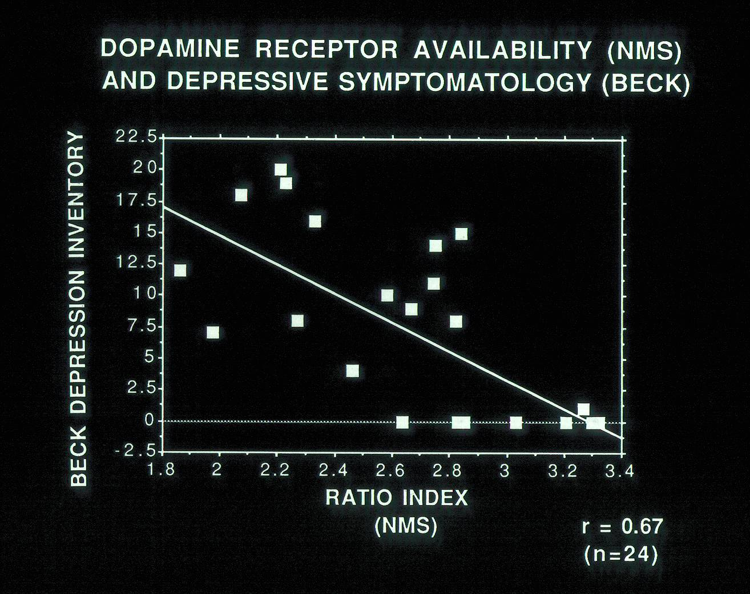

Slide 40
Dopamine
Link with addictive behaviour
Bingeing
Alcohol
Tobacco
Substance Abuse
Risk taking

Slide 41
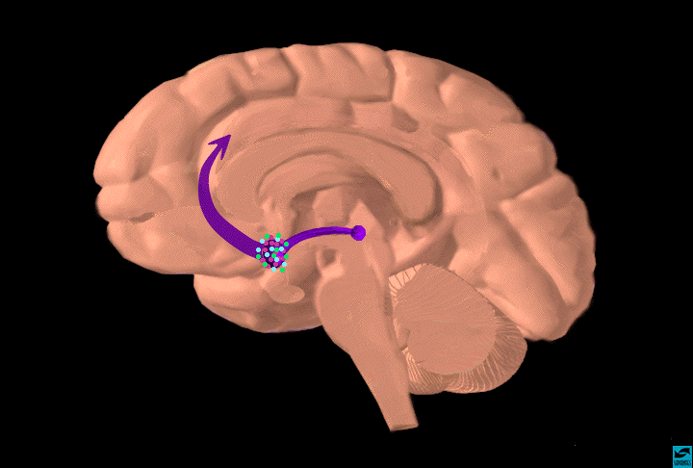
Effects of Drugs on Dopamine Levels
Dopamine Pathways
Principal “Pleasure”
System of the Brain
1100
Accumbens
AMPHETAMINE
Accumbens
COCAINE
1000
400
900
800
DA
300
DA
700
600
% of Basal Release
500
% of Basal Release
200
400
300
200
100
100
0
0
1
2
3
4
5 hr
0
Time After Amphetamine
0
1
2
3
4
5 hr
Source: Di Chiara and Imperato
Time After Cocaine
Natural Rewards Elevate Dopamine Levels
striatum
frontal
cortex
hippocampus
200
FOOD
200
SEX
substantia
nigra/VTA
150
NAC shell
150
100
100
15
nucleus
accumbens
% of Basal DA Output
50
Empty
DA Concentration (% Baseline)
10
Box
Feeding
Copulation Frequency
5
0
0
60
120
180
Scr
Scr
Scr
Scr
0
Bas
Female 1 Present
Female 2 Present
Time (min)
1
2
3
4
5
6
7
8
9
10
11
12
13
14
15
16
17
Sample
Number
Mounts
Intromissions
Ejaculations
Di Chiara et al.
Fiorino and Phillips

Slide 42
Serotonin
Serotonin

Slide 43
Serotonin
Serotonin is a monoamine neurotransmitter. Most is produced by and found in the intestine (approximately 90%), and the remainder in central nervous system neurons.
It functions to regulate appetite, sleep, memory and learning, temperature, mood, behaviour, muscle contraction, and function of the cardiovascular system and endocrine system.

Slide 44
Serotonin
It is speculated to have a role in depression, as some depressed patients are seen to have lower concentrations of metabolites of serotonin in their cerebrospinal fluid and brain tissue .
Introduction to Serotonin, University of Bristol - http://tinyurl.com/67tw9k

Slide 45
Serotonin
Serotonin, a neurotransmitter that is in many ways the opposite of the catecholamines, is also directly synthesised from an amino acid (tryptophan).
This amino acid is not permitted for sale in the UK.

Slide 46
Serotonin
However, tryptophan has a somewhat different process of degradation. When serotonin is catabolised in the body, it does not break down into useful substrates in the way that dopamine is further degraded into epinephrine and norepinephrine.
Instead, it breaks down into 5-hydroxyindoleacetic acid (5-HIA), an organic acid which may be harmful in high amounts.
Tryptophan can further be catabolised into kynurenate, quinolinate, and picolinate, harmful substances that are generally regarded as markers of bodily inflammation.

Slide 47
Serotonin
Administration of L-tryptophan, a precursor for serotonin, is seen to double the production of serotonin in the brain. It is significantly more effective than a placebo in the treatment of mild and moderate depression. This conversion requires vitamin C.
Meyers, S (2000). "Use of Neurotransmitter Precursors for Treatment of Depression". Alternative Medicine Review 5 (1): 64–71. http://tinyurl.com/6j3ewfv
Introduction to Serotonin, University of Bristol, retrieved 18.2.11 - http://tinyurl.com/67tw9k

Slide 48
Serotonin
5-hydroxytryptophan (5-HTP), also a precursor for serotonin, is also more effective than a placebo and nearly as effective or of equal effectiveness to some antidepressants.
Interestingly, it takes less than 2 weeks for an antidepressant response to occur, while antidepressant drugs generally take 2–4 weeks. 5-HTP also has no significant side effects.

Slide 49
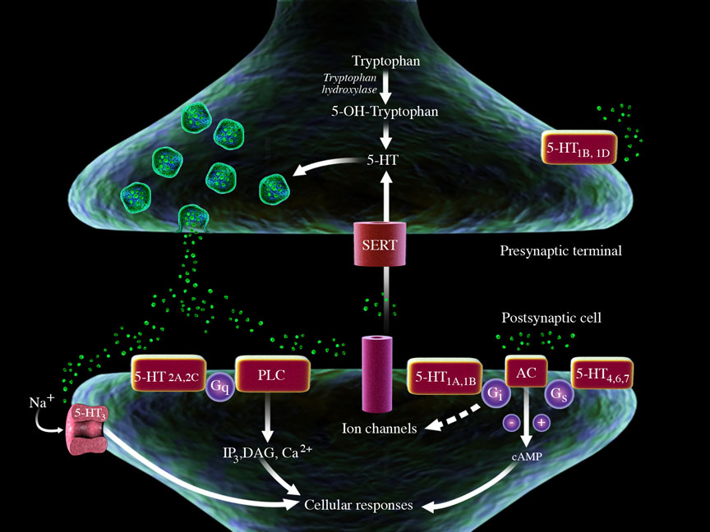

Slide 50
Serotonin
Administration of 5-HTP bypasses the rate-limiting step in the synthesis of serotonin from tryptophan. Also, 5-HTP readily passes through the blood-brain barrier, and enters the central nervous system without need of a transport molecule.
Note, however, that there is some evidence to suggest that a post-synaptic defect in serotonin utilisation may be an important factor in depression, not only insufficient serotonin.

Slide 51
Serotonin – Core Symptoms
Disruption in homeostasis
Reduced appetite
Anxiety
Hypervigilance
Depression
Sleep Disorders
Major depression
PTSD
Panic attacks
OCD
Autism
Schizophrenia

Slide 52
GABA
GABA

Slide 53
GABA
GABA is used at the great majority of fast inhibitory synapses in virtually every part of the brain. Many sedative/tranquilising drugs act by enhancing the effects of GABA.
Correspondingly, glycine is the inhibitory transmitter in the spinal cord.

Slide 54
GABA
GABA is the primary inhibitory neurotransmitter in the brain
GABA plays a critical role in cell to cell contact
GABA receptors mediate anxiolytic, sedative, and anti-convulsant activity

Slide 55
GABA
Core symptoms
Anxiety
Depression
Restlessness, excessive worrying
Sleep disturbances, insomnia

Slide 56
GABA
Core conditions
Psychiatric
Bipolar disease
Schizophrenia
PTSD
Panic and Anxiety
Treatment-refractory depression
Seizures

Slide 57
GABA
Metabolism of GABA
GABA is formed from glutamate via glutamic acid decarboxylase (GAD)
GAD requires pyridoxine as cofactor
GAD upregulated by taurine
GAD activity is inhibited by elevated methionine and cortisol
Diminished GAD activity leads to reduced GABA function and is associated with several neuropsychiatric conditions including schizophrenia, epilepsy, and bipolar disease

Slide 58
OUT
Cl⁻
Na⁺
GABA
Glu
Cl⁻
Na⁺
GABA_{A} receptor
Glutamate/AMPA
receptor
Inhibition
Excitation
IN

Slide 59
Cortical GABA Concentrations in Healthy and Depressed Subjects
3.0
3.0
2.5
2.5
2.0
2.0
Cortical GABA mmole s’Kg Brain
1.5
1.5
1.0
1.0
0.5
0.5
0.0
0.0
Healthy Males
Depressed Males
Healthy Females
Depressed Females
Sanacora et al. Arch Gen Psychiatry. 1999;56:1043-47.

Slide 60
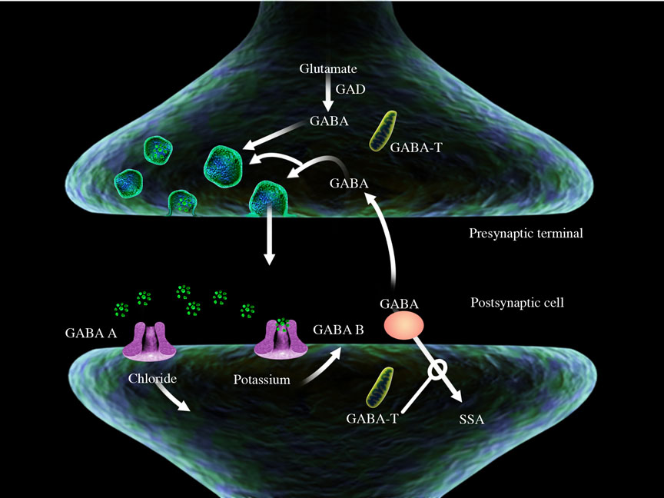

Slide 61
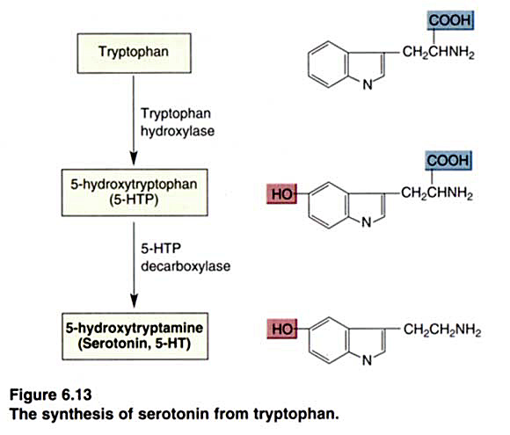
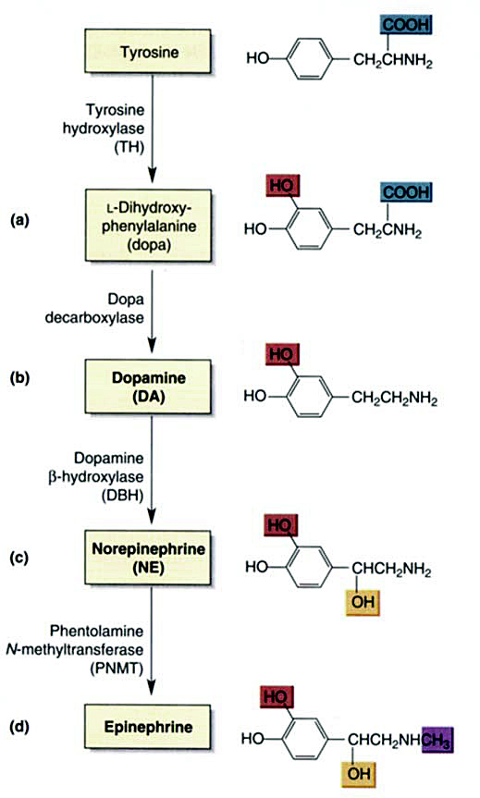
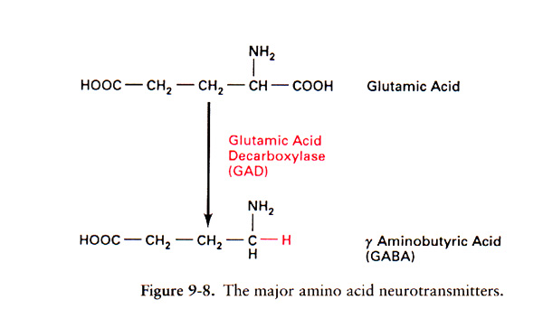
Some Neurotransmitter
Precursors

Slide 62
Signs & Symptoms
Signs & Symptoms of Too High and Too Low a Level
of Neurotransmitters

Slide 63
Glutamate
Too high a level
Neuro-degenerative diseases
Paroxysmal symptoms
Hyperactivity
Migraines
Poor attention
Irritability
Explosive behaviours
Anger attacks
Aggression
Poor mood / mood swings
Bipolar disease

Slide 64
Dopamine
Too low a level
Inability to concentrate
Poor attention & poor attention to detail
Poor memory
Reduced ability to feel pleasure
Flat, bored, apathetic and low enthusiasm
Depressed
Low drive and motivation
Restless
Impatient
Difficulty getting through a task even when interesting
Too low a level
Crave uppers (e.g. caffeine/nicotine/diet soft drinks)
Shy/introvert
Low libido or impotence
Mentally fatigued easily and physically fatigued easily
Put on weight easily
Procrastinator/little urgency
Sleep too much and trouble getting out of bed
Prone to addictions (e.g. alcohol, cigarettes)/addictive personality
Drug abuse
Family history of alcoholism/ADD/ADHD

Slide 65
Dopamine
Too high a level
Psychosis
OCD
Anxiety
Aggression
Poor impulse control
Low pain threshold

Slide 66
GABA
Too low a level
Anxiety
Phobias
Feel stressed/pressured/overwhelmed
Butterflies in stomach
Lump in throat
Have trouble relaxing/loosening up
Low stress tolerance
Body tends to be tense/stiff/uptight
Too low a level
Trembling/twitching/shaking
Anxious/nervous/jumpy/
‘on edge’
Sleep problems or chronic pain
Use alcohol/food/cigarettes to relax
Family history of anxiety
Valium/Xanax/Avitan/GABA reduce above symptoms

Slide 67
Serotonin
Too low a level
Depression
Anxiety
Melancholic
Insomnia / Sleep problems / Light sleeper
Nervous
Worrier
Poor response to stress
Negative / Pessimistic
Irritable / impatient/edgy
Self destructive, masochistic or suicidal thoughts / plans
Too low a level
Think about the same things over & over again
Low self esteem / confidence
Feel worse in and dislike dark weather
Anger / rage / explosive behaviour / assaultive
Inflammation / chronic pain
PMS
Anti-depressants / 5HTP improve mood
Family history of depression / anxiety / OCD / eating disorders

Slide 68
The Nutrient Connection
The Nutrition Connection

Slide 69
Diet Essentials
Balance blood glucose
Ensure high quality protein at three meals a day
Eat fresh coloured veg at lunch & dinner
Drink water throughout the day (2+ litres)
Only consume moderate to low GL carbohydrates
Ensure a wide variety of foods
Do not eat large meals
Avoid refined sugar & alcohol & smoking …

Slide 70
The Nutrition Connection
Specific Nutrients

Slide 71
Magnesium
Magnesium is involved in enzymatic pathways which control mitochondrial ATP production
Magnesium reduces elevated lactate and glutamate produced under ischemic conditions
Functions in a manner similar to Memantine, a non competitive NMDA receptor antagonist approved for the treatment of Alzheimer’s disease

Slide 72
Magnesium
Magnesium preserves pyruvate and glucose metabolism
Magnesium blocks NMDA voltage gated receptors and thereby reduces excitatory post synaptic receptors (Hallak. American J Obstet Gynecol 2000 ;183:793-98)
Inhibits intracellular calcium and sodium influx
Magnesium deficiency results in increased neuromuscular irritability, tremors, myoclonic jerks and seizures

Slide 73
Vitamin D
The role of Vitamin D & Calcium

Slide 74
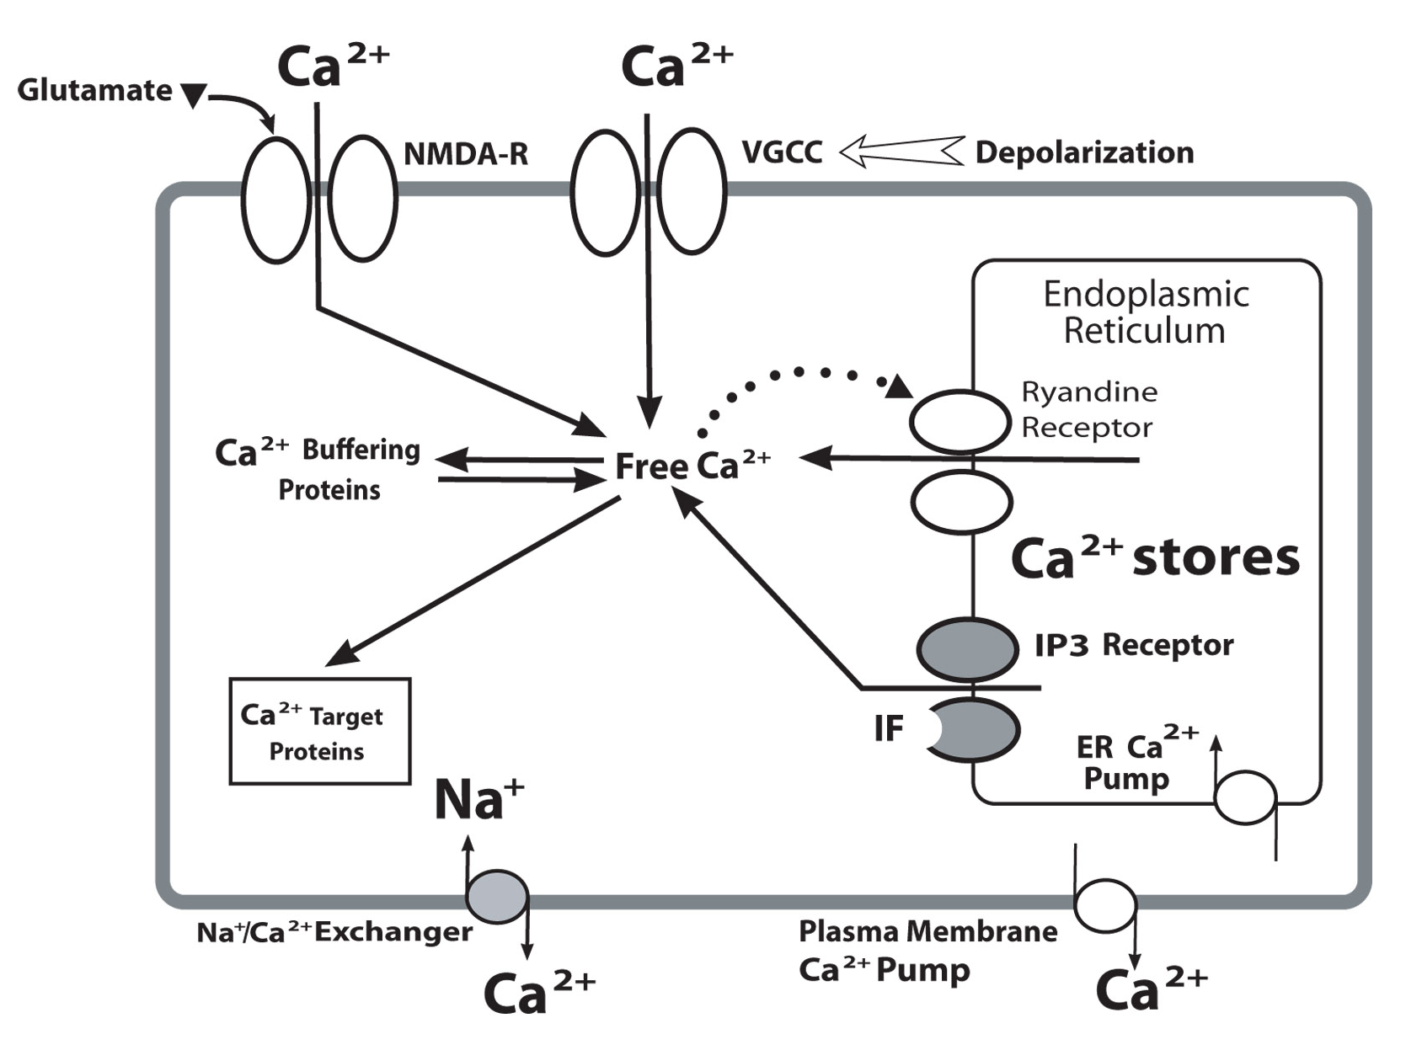
Vitamin D buffers against hyperactivation of intracellular Calcium Increases Calcium Binding Protein = Calbendin
Natural Glutamate antagonist

Slide 75
Promoting GABA & Glutamate Balance
Taurine | Acts as an endogenous GABA agonist Rescues neurons from excito-toxic effects induced by elevated glutamate
Magnesium (malate) | Blocks NMDA voltage gated receptors reducing excitatory post synaptic receptors Reduces neuromuscular irritability, seizures, etc.
B₆ | Cofactor in synthesis of gaba from the enzyme glutamic acid decarboxylase (GAD)
Green tea extract (Camilla sinensis) – 60% catechins, 40% EGCG | Attenuates glutamate cytotoxicity Activates PI3/AKT and inhibits GSK3, an effect similar to lithium
N-acetylcysteine (NAC) | Natural NMDA receptor antagonist Protect nerve cells from harmful excitotoxic effects Precursor to glutathione, a primary antioxidant in the body as well as in the central nervous system

Slide 76
Nutritional Supplements - NAC
NAC is the n-acetyl derivative of L-cysteine and plays a major role in hepatic glutathione production
Down regulates glutamate activity by its involvement with the cysteine-glutamate transporter: Intracellular cysteine entry in exchange for export of glutamate
Significant effects reported in psychiatric disorders including: Augmentation of serotonin reuptake inhibitors for the treatment of OCD (Psychopharmacology 2006. Jan 254-6); Reduction of self injurious behaviour. (J Clinical Psychiatry Nov 05,1494-97) and Autism (publication pending)

Slide 77
Nutritional Supplements - Taurine
Activates GABA (A) receptors in hippocampus (Brain Research 2000, May 12(2);864:298-307)
Taurine also enhances brain GABA levels by inhibiting GABA transaminase and stimulating GAD
Rescues cortical neurons from high concentrations of extracellular glutamate and neurotoxic effects of amyloid (Neuropharmacology 2005;49:1140-48)
Anxiolytic effect observed in animal studies (Life Science 2004;75: 1503-1511)
Anti-convulsant and mood stabilizing effect of Lamotrigine proposed to relate to elevated taurine (Epilepsy Research 2001;43: 153-63)

Slide 78
Neuroprotectants
Primary
AR - NAC Enhanced Antioxidant Formula 1 tab on empty stomach, b.i.d.
AR - Fibroboost (E. Cava extract) - 2 caps 30 mins before breakfast & lunch
Secondary
BR - Vasculo-Sirt - 1-2 with each meal
AR - MVM-A - 1 with each meal
AR - Acetyl-L-Carnitine - 2 caps on empty stomach, 1-2 X per day
AR - Magnesium Malate Forte - 1 tab with each meal

Slide 79
Glutamate
Primary
Supports a healthy reduction
AR - MVM-A - 1 with each meal
AR - NAC Enhanced Antioxidant Formula - 1 tab on empty stomach, b.i.d.
AR - Magnesium Malate Forte - 1 tab with each meal
Secondary
BR - B6 Phosphate 1-2 tabs with each meal
AR - Taurine 500 mg 1 caps on empty stomach, b.i.d.
BR - Bio D Mulsion Forte 2-10,000 iu daily

Slide 80
Dopamine
Primary
Supports a healthy increase
AR - L-Tyrosine 500 mg - 1 caps on empty stomach, b.i.d.
BR - A.D.H.S - 2 at breakfast, 2 at noon
Secondary
BR - De-Stress (Casein Concentrate) - 1 caps on empty stomach, 2-3 x per day

Slide 81
Serotonin
Primary
Supports a healthy increase
BR - Neuro-5-HTP Plus 1-2 caps on empty stomach, 2-3 x per day
AR – Seratonin - 3 caps with breakfast, with later doses as directed by practitioner
Secondary
AR - 5HTP 50 mg 1-2 caps on empty stomach, 1- 2 x per day

Slide 82
GABA
Primary
Supports a healthy increase
AR - 200 mg of Zen - 1 caps on empty stomach, b.i.d.
BR - Neuro-5-HTP Plus - 1 caps on empty stomach, t.i.d.
AR – Magnesium Malate Forte - 1 tab with each meal

Slide 83
GABA
Secondary
BR - B6 Phosphate - 1-2 tabs with each meal
AR - NAC Enhanced Antioxidant Formula - 1 tab on empty stomach, b.i.d.
AR - Taurine 500 mg - 1 caps on empty stomach b.i.d.

Slide 84
Hypercortisolaemia
Primary
Supports a healthy Reduction
AR - Phos Serine Complex (high night-time & morning cortisol) - 1-2 at dinner
BR - ADHS (high morning cortisol) - 2 at breakfast, 2 at noon
BR - GlucoBalance (high day-time cortisol) - 1-2 3 x a day
AR - Magnesium Malate Forte (high cortisol at any time) - 1 at each meal

Slide 85
Stress
Primary
Supports a healthy reduction
BR - Neuro-5-HTP - 1 caps on empty stomach 2-3 x per day
AR - 200 mg of Zen - 1 caps on empty stomach, b.i.d.

Slide 86
Vs Stress
Supports a healthy increase in tolerance
AR – Stabilium - 4 caps first thing for 2 weeks, then 2 caps first thing thereafter
Secondary
BR – ADHS - 2 at breakfast, 2 at noon
FF - Adrenal Rebuilder - 1-2 with each meal, not after 7pm
AR - Magnesium Malate Forte - 1 with each meal

Slide 87
Summary
Insulin & cortisol, when out of balance, have profound effects on mood and well-being.
Nutrition plays a key role in the level and balance of these key determinants in our mood.
It is NOT possible to measure levels of neurotransmitters with blood or urine tests (ref Dr Jay Lombard).
Specific signs & symptoms give a sound clinical picture of neurotransmitter imbalances.
The appropriate eating plan and key nutrients have been shown to correct imbalances in these hormones & neurotransmitters.

Slide 88
Technical Support
To help you decide if specific nutrients could be helpful to you to balance your hormones & neurotransmitters, please do call, for no charge, the Nutri-Link Technical Support
Direct line, local call rate: 08458 94 97 67

